Slide 1
Unsupervised Learning

Slide 2
CONTENT
INTRODUCTION
CLUSTERING
BLIND SIGNAL SEPARATION
SELF-ORGANIZING MAPS(SOM)

Slide 3
Introduction
Unsupervised learning studies how systems can learn to represent particular input patterns in a way that reflects the statistical structure of the overall collection of input patterns.
There are no explicit target outputs rather the unsupervised learner brings to bear prior biases as to what aspects of the structure of the input should be captured in the output.
indeed structural and physiological properties of synapses in the neocortex are known to be substantially influenced by the patterns of activity in sensory neurons that occur.
essentially none of the information about the contents of scenes is available during learning.

Slide 4
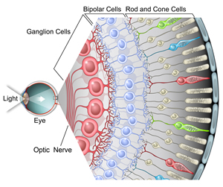
Unsupervised learning is important since it is likely to be much more common in the brain than supervised learning.
For instance there are around 106 photoreceptors in each eye whose activities are constantly changing with the visual world and which provide all the information that is available to indicate what objects there are in the world, how they are presented, what the lighting conditions are, etc.

Slide 5
Horace Barlow (see Barlow, 1992), who sought ways of characterizing neural codes,
David Marr (1970), who made an early unsupervised learning postulate about the goal of learning in his model of the neocortex.
The Hebb rule (Hebb, 1949), which links statistical methods to neurophysiological experiments on plasticity
Geoffrey Hinton and Terrence Sejnowski in inventing a model of learning called the Boltzmann machine (1986)
History

Slide 6
Examples of unsupervised learning approaches
Clustering.
Blind signal separation.
Self organizing maps

Slide 7
Clustering
It is the task of grouping a set of objects in such a way that objects in the same group (called a cluster) are more similar to each there than to those in other groups (clusters).
It is a main task of exploratory data mining , and a common technique for statistical data analysis .
used in many fields, including machine learning , pattern recognition image analysis.

Slide 8
Clustering algorithms
Hierarchical clustering
creating clusters that have a predetermined ordering from top to bottom. For example, all files and folders on the hard disk are organized in a hierarchy.
Agglomerative algorithm.
Divisive algorithm.
Partitional clustering
Decompose the data set into a set of disjoint clusters
K-mean algorithm.

Slide 9
Hierarchical clustering
Agglomerative clustering
In this method we assign each observation to its own cluster.
Then, compute the similarity (e.g., distance) between each of the clusters and join the two most similar clusters.
Finally, repeat steps 2 and 3 until there is only a single cluster left. The related algorithm is shown below.
Divisive clustering
In this method we assign all of the observations to a single cluster and then partition the cluster to two least similar clusters. Finally, we proceed recursively on each cluster until there is one cluster for each observation.

Slide 10
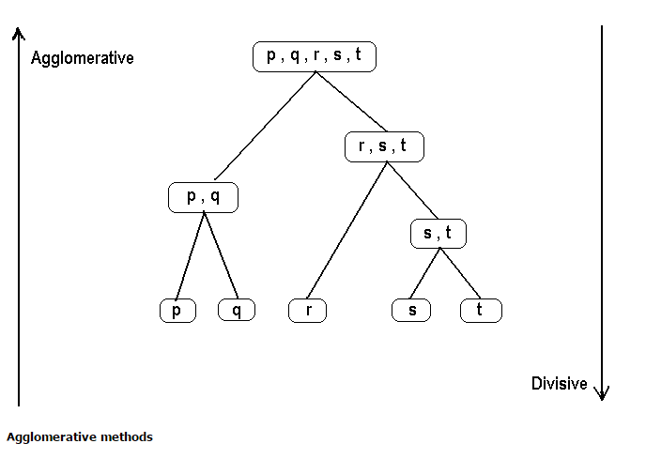

Slide 11
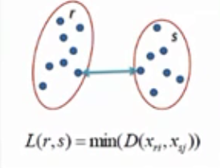
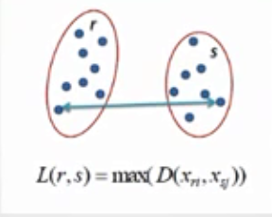
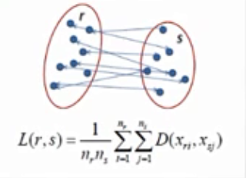
proximity matrix
Before any clustering is performed, it is required to determine the proximity matrix containing the distance between each point using a distance function. Then, the matrix is updated to display .the distance between each cluster
Single Linkage Complete Linkage Average Linkage

Slide 12
Blind signal separation
Blind signal separation, also known as blind source separation.
is the separation of a set of source signals from a set of mixed signals, without the aid of information (or with very little information) about the source signals or the mixing process.
methods for blind source separation generally seek to narrow the set of possible solutions in a way that is unlikely to exclude the desired solution.

Slide 13
Recently, blind source separation by Independent Component Analysis (ICA) has received attention because of its potential applications in signal processing such as in speech recognition systems, telecommunications and medical signal processing.
The goal of ICA is to recover independent sources given only sensor observations that are unknown linear mixtures of the unobserved independent source signals.
ICA not only de correlates the signals (2nd-order statistics) but also reduces higher-order statistical dependencies, attempting to make the signals as independent as possible.

Slide 14
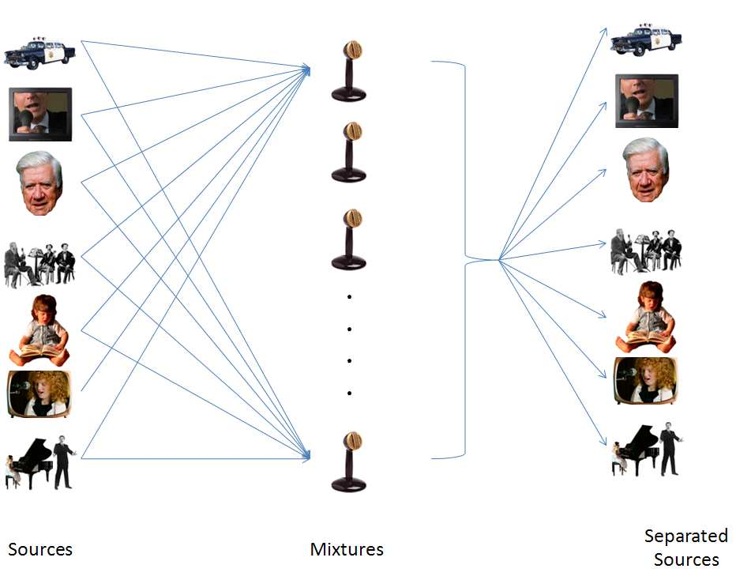
Partitioning techniques

Slide 15
Self-organizing Maps(SOM)
Self-Organizing Map (SOM) is an unsupervised learning algorithm.
SOM is a visualization method to represent higher dimensional data in an usually 1-D, 2-D or 3-D manner.
SOMs have two phases:
Learning phase: map is built, network organizes using a competitive process using training set.
Prediction phase: new vectors are quickly given a location on the converged map, easily classifying or categorizing the new data.

Slide 16
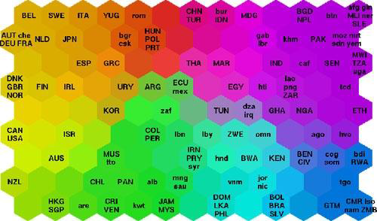
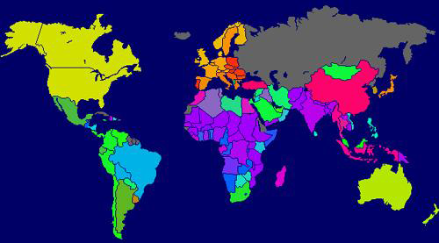
Applications of SOMs
SOMs are commonly used as visualization aids. They can make it easy for us humans to see relationships between vast amounts of data
World Poverty Map

Slide 17
Example: Data sets for poverty levels in different countries.
Data sets have many different statistics for each country.
SOM does not show poverty levels, rather it shows how similar the poverty sets for different countries are to each other.

Slide 18
Thank you !!!!

